Slide 1
Chapter 5: Plotting and Visualization
Data Science with Python

Slide 2
Chapter Objectives
In this chapter, we will introduce:
Matplotlib
Plotting functions in pandas
Python visualization tool ecosystem

Slide 3
Chapter Concepts
Introducing Matplotlib
Plotting Functions in Pandas
Python Visualization Tool Ecosystem
Chapter Summary

Slide 4
Introducing Matplotlib
matplotlib is a plotting package designed for creating publication quality plots
Has a number of add-on toolkits
3D plots
Mapping and projections
pyplot is a module built on matplotlib
Run in pylab mode in IPython
In this chapter, we provide enough detail to begin working with matplotlib
Full documentation including extensive examples can be found at:
http://matplotlib.org/2.0.0/index.html

Slide 5
Figures and Subplots
Plots reside within a Figure object
Subplots are added to a Figure object
Using add_subplot(rows, columns, plot number)
Returns AxesSubplot objects
2x2 subplots, subplot 1
In [75]: figure = plt.figure()
In [76]: sp1 = figure.add_subplot(2,2,1)
In [77]: sp2 = figure.add_subplot(2,2,2)
In [78]: sp3 = figure.add_subplot(2,2,3)
In [79]: sp4 = figure.add_subplot(2,2,4)
In [80]: sp1.plot(randn(100).cumsum(), 'k—')
In [81]: sp2.hist(randn(100), bins=20)
In [82]: sp3.scatter(randn(100), randn(100)-5*randn(100))
In [83]: sp4.hist(randn(100), bins=20, color='r')
2x2 subplots, subplot 2

Slide 6
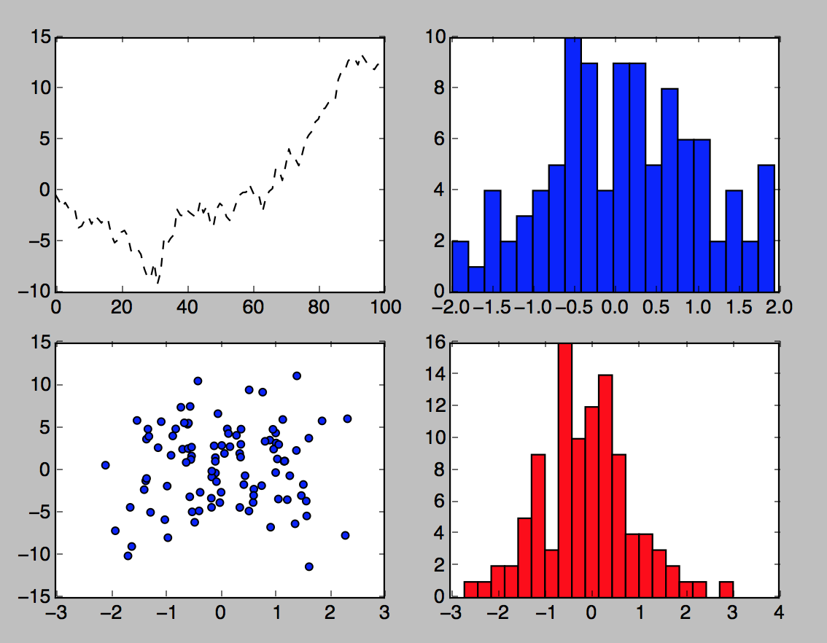
Figures and Subplots Example

Slide 7
Colors and Styles
The plot function accepts arrays of x and y coordinates and also an optional string
Optional string is for color and style
E.g., sp1.plot(x,y,'r—')
r indicates red color and -- is the dashed style
More explicit requests for color and style can be made
E.g., sp1.plot(x,y,linestyle='—', color='r')
Plots will have continuous line plots and, therefore, will have data interpolated
Can request data points to be shown
E.g., sp1.plot(x,y,'ro—')
Or sp1.plot(x,y,linestyle='—', color='r', marker='o')

Slide 8
Labels and Legends
Following example shows how to change axis ticks, labels, and add a title
In [128]: figure = plt.figure()
In [129]: p1 = figure.add_subplot(1,1,1)
In [130]: p1.plot(randn(1000).cumsum())
In [131]: p1.set_title('Random Walk')
In [132]: p1.set_xticks([0,500,1000])
In [133]: p1.set_xlabel('Count')
In [134]: p1.set_ylabel('Random Number')
set_yticks for Y axis

Slide 9
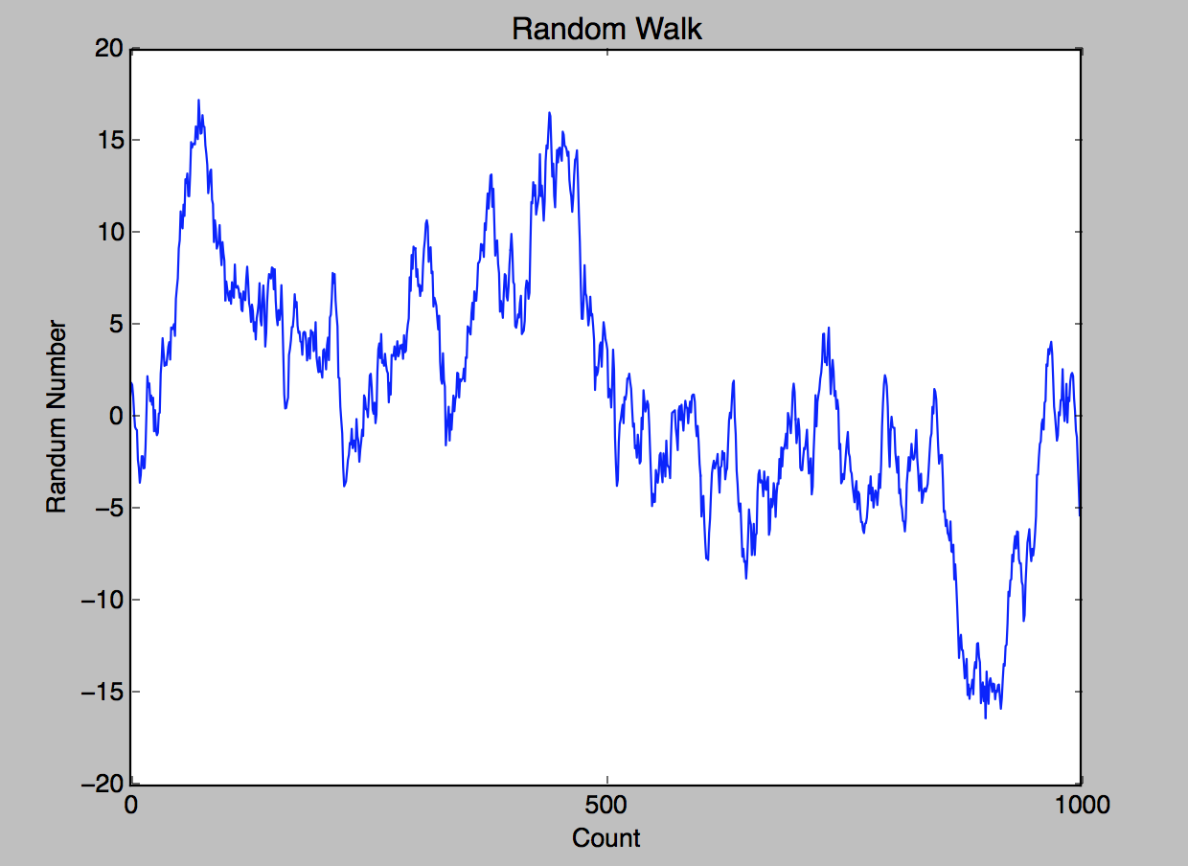
Labels and Legends Example
Random Number

Slide 10
Chapter Concepts
Introducing Matplotlib
Plotting Functions in Pandas
Python Visualization Tool Ecosystem
Chapter Summary

Slide 11
Plotting Functions in Pandas
Pandas objects have built-in plotting functions
Simplify working with matplotlib
In particular, for DataFrame objects
Provide support for a number of different chart types such as:
Line plots
Bar plots
Histograms
Density plots
Scatter plots
Etc.

Slide 12
A Simple Example
Consider plotting the function f(x)=cos(x)
In [1]: pylab
In [2]: import numpy as np
In [3]: import pandas as pd
In [4]: from pandas import Series, DataFrame
In [5]: ts = Series(np.random.randn(1000), index=pd.date_range('1/1/2000', periods=1000))
In[6]: ts.cumsum()
In [6]: ts.plot()
Built-in function

Slide 13
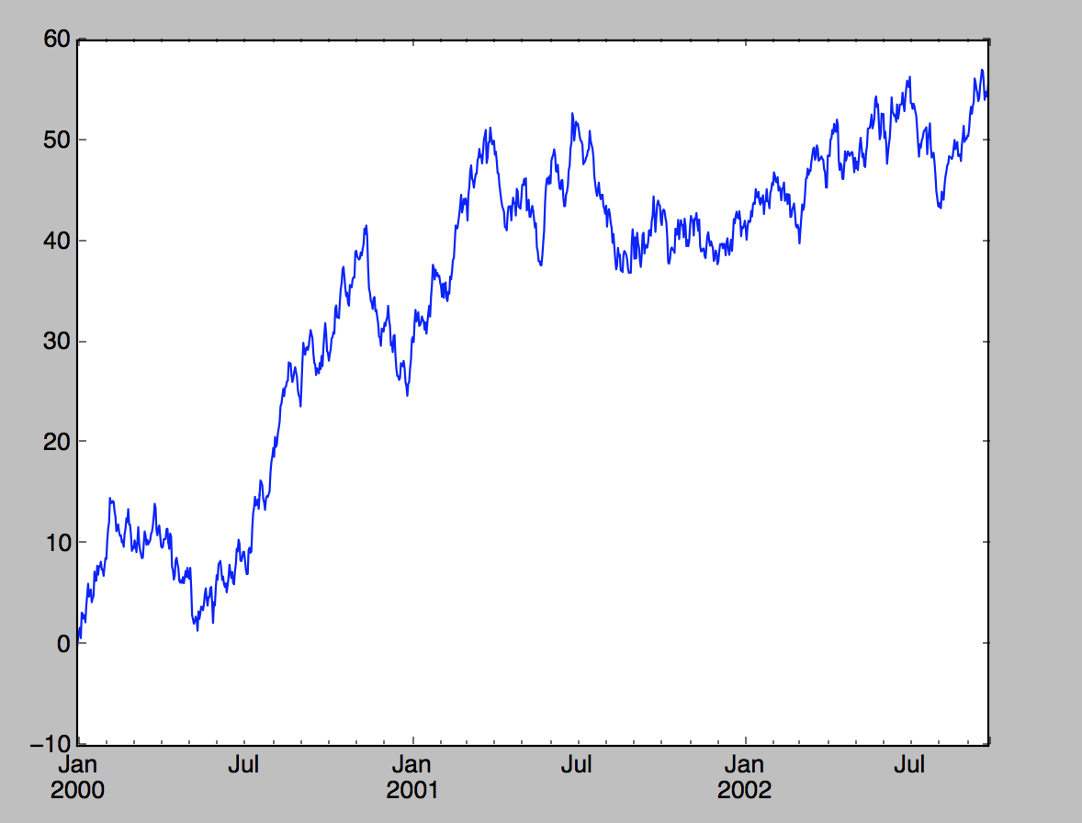
A Simple Example (continued)

Slide 14
Line Plot with DataFrame
DataFrame’s plot method plots each of its columns as a different line
On the same plot
A legend is created automatically
In [17]: ts = Series(np.random.randn(1000), index=pd.date_range('1/1/2000', periods=1000))
In [18]: df = DataFrame(np.random.randn(1000,4),
index= ts.index, columns=list('ABCD'))
In [19]: df = df.cumsum()
In [20]: df.plot()
Used in legend

Slide 15
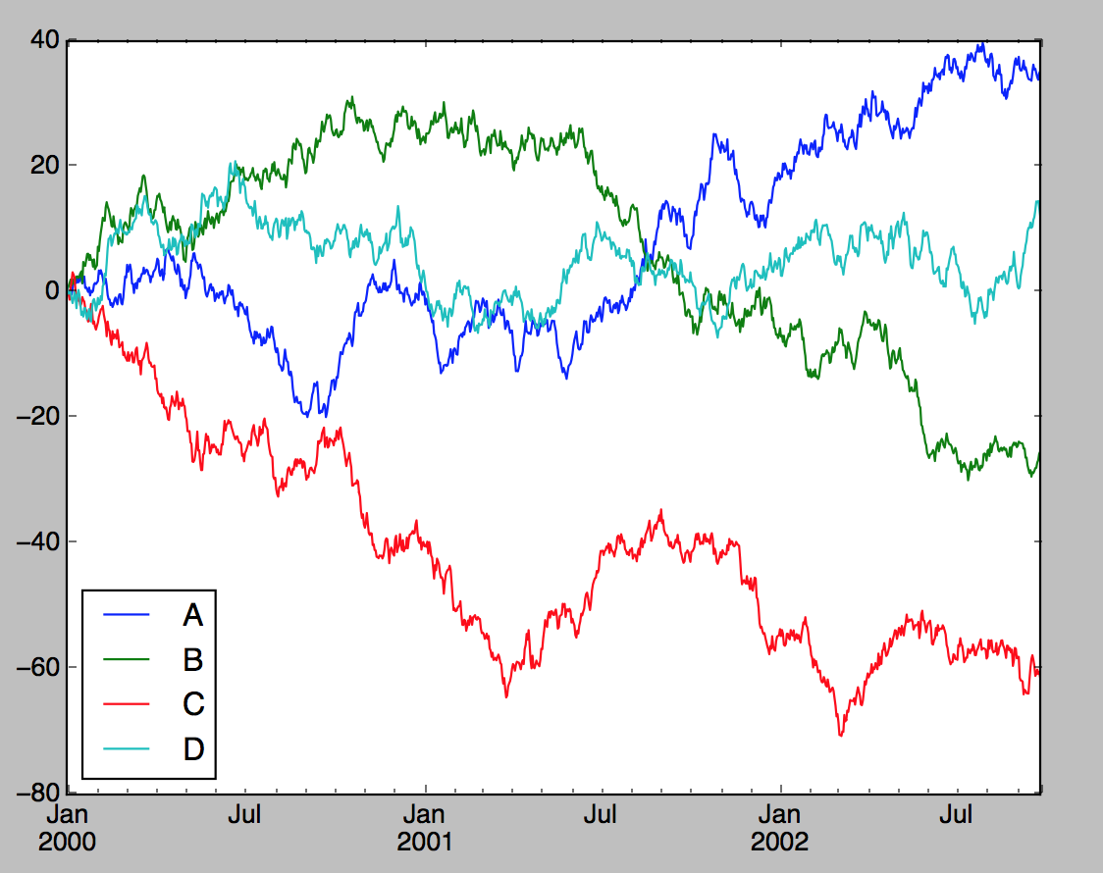
Line Plot with DataFrame (continued)

Slide 16
Series plot() Arguments
Series plots can be customized using arguments to plot()
label
Label for plot legend
style
String such as ‘g—’ for matplotlib
alpha
Fill opacity from 0 to 1
kind
Line, bar, barh, kde
grid
Display axis grid
logy
Use logarithmic scaling on the Y axis
For full list, see:
http://pandas.pydata.org/pandas-docs/stable/generated/pandas.Series.plot.html

Slide 17
DataFrame plot() Arguments
Series plots can be customized using arguments to plot()
subplots
Plot each DataFrame in separate subplot
sharex
Share same x axis for subplots
sharey
Share same y axis for subplots
figsize
Size of figure to create
title
Plot title as a string
legend
Add a subplot legend
sort_columns
Plot columns in alphabetical order using existing column order
For full list, see:
http://pandas.pydata.org/pandas-docs/stable/generated/pandas.DataFrame.plot.html

Slide 18
Histogram Example
In [22]: df = pd.DataFrame({'A': np.random.randn(1000) + 1,
'B': np.random.randn(1000),
'C': np.random.randn(1000)-1})
In [23]: print df.head()
A B C
0 0.627152 1.984009 0.785683
1 1.316856 0.318605 0.143795
2 -0.763011 -0.261403 -1.346760
3 1.174517 1.044114 0.556043
4 1.052025 -0.021766 -1.868798
In [24]: df.plot(kind='hist')
Select histogram

Slide 19
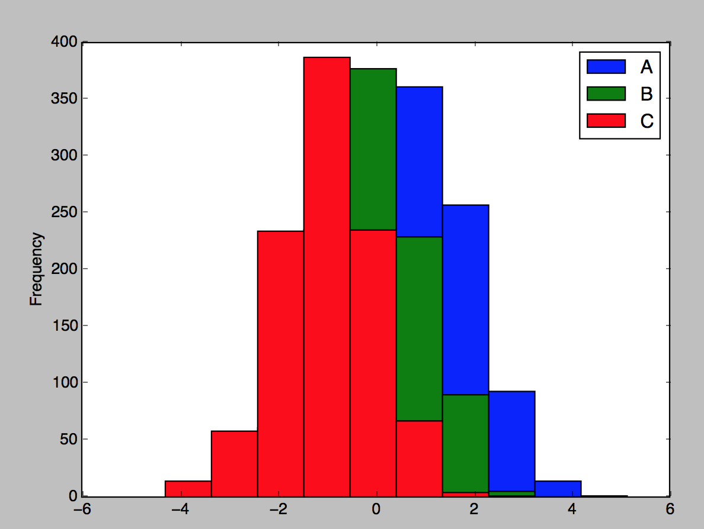
Histogram Example (continued)

Slide 20
Scatter Plots
Useful way of visualizing relationship between two one-dimensional data series
matplotlib and pyplot have a scatter method for plotting charts
In [30]: df.head()
Out[30]:
A B C
0 0.627152 1.984009 0.785683
1 1.316856 0.318605 0.143795
2 -0.763011 -0.261403 -1.346760
3 1.174517 1.044114 0.556043
4 1.052025 -0.021766 -1.868798
In [31]: plt.scatter(df['A'], df['B'])
In [32]: plt.title('Changes in A v changes in B')
Scatter plot

Slide 21
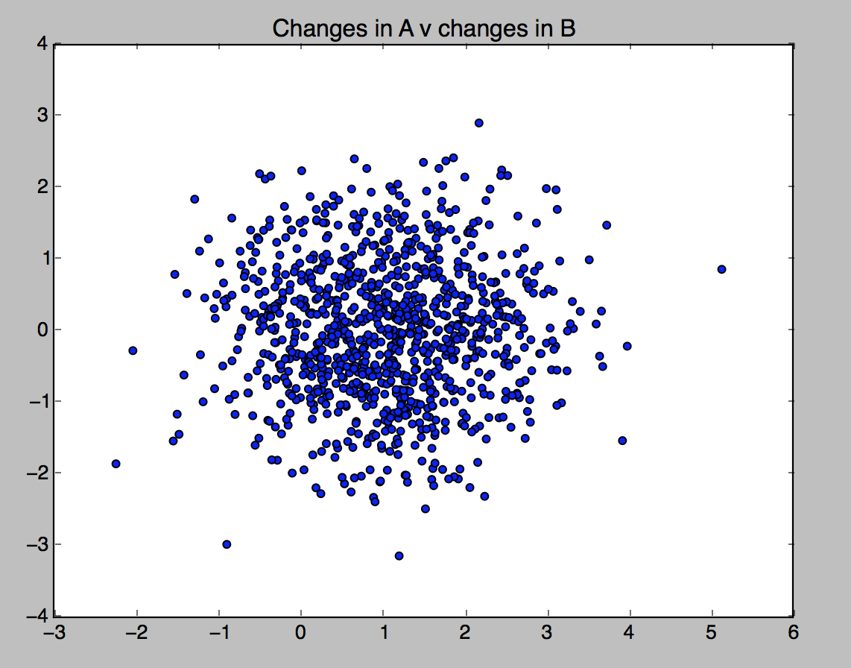
Scatter Plots (continued)

Slide 22
Scatter Plot Matrix
For exploratory data analysis, it may be helpful to look at all scatter plots amongst a group of variables
Known as a pair plot or scatter plot matrix
Pandas has scatter_matrix function
Works with a DataFrame
Also supports placing histograms or density plots of each variable along the diagonal
In [38]: df.head()
Out[38]:
A B C
0 0.627152 1.984009 0.785683
1 1.316856 0.318605 0.143795
2 -0.763011 -0.261403 -1.346760
3 1.174517 1.044114 0.556043
4 1.052025 -0.021766 -1.868798
In [39]: pd.scatter_matrix(df, diagonal='kde',alpha=0.3)
Density plot on diagonal

Slide 23
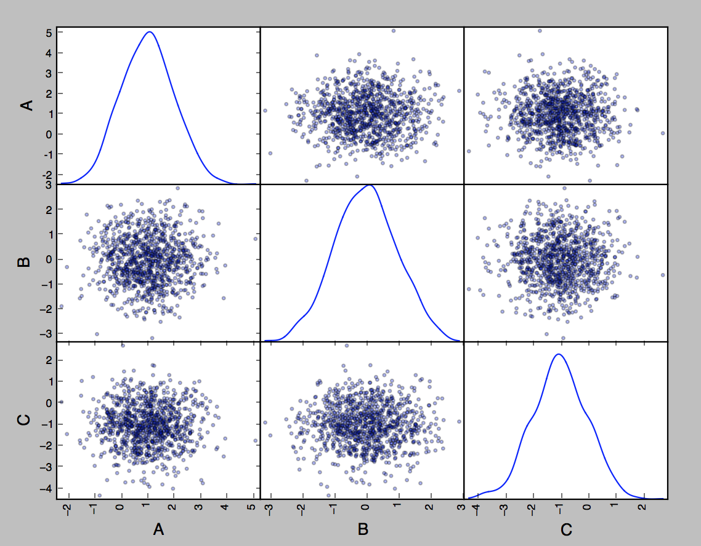
Scatter Plot Matrix Example

Slide 24
Chapter Concepts
Introducing Matplotlib
Plotting Functions in Pandas
Python Visualization Tool Ecosystem
Chapter Summary

Slide 25
Python Visualization Tool Ecosystem
There are many options for creating graphics in Python
Two of the more popular ones are:
Chaco
Used for static plotting and interactive visualizations
Very fast rendering
Mayavi
3D graphics toolkit
Allows interactive visualizations
Pan, zoom, rotate, etc.

Slide 26
Exercise 5.1
Please turn to the Exercise Manual and complete Exercise 5.1: Working with Matplotlib

Slide 27
Chapter Concepts
Introducing Matplotlib
Plotting Functions in Pandas
Python Visualization Tool Ecosystem
Chapter Summary

Slide 28
Chapter Summary
In this chapter, we have introduced:
Matplotlib
Plotting functions in pandas
Python visualization tool ecosystem

